Slide 1

Code In Place
Imagine you are carrying a heavy school bag on the earth. Now if you go to mars would it feel lighter or the same
      ??

Slide 2
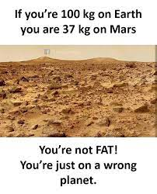
Problem
An earthling’s weight on Mars is 37.8% (0.378)of their weight on the Earth.
Write a program that prompt the user (an earthling ) to enter their weight on Earth and print their calculated weight on mars

Slide 3
Important
Before diving into writing the program, we will first understand the following terminologies:
Variable
Type Casting
Function

Slide 4
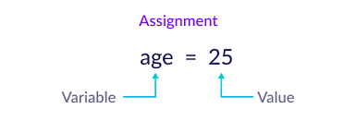
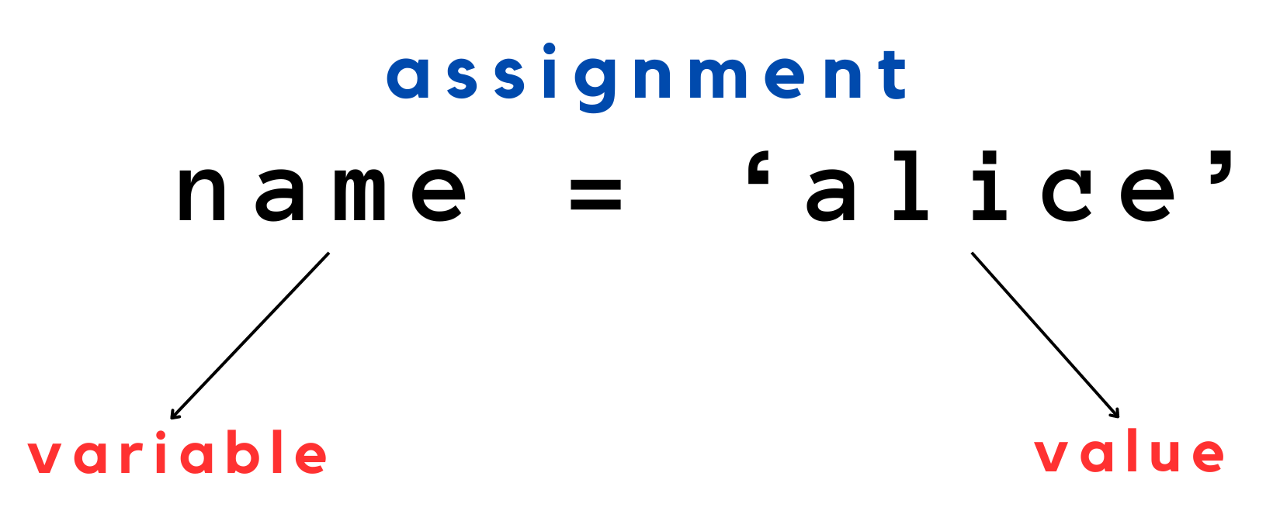
Variable and Type Casting

Slide 5
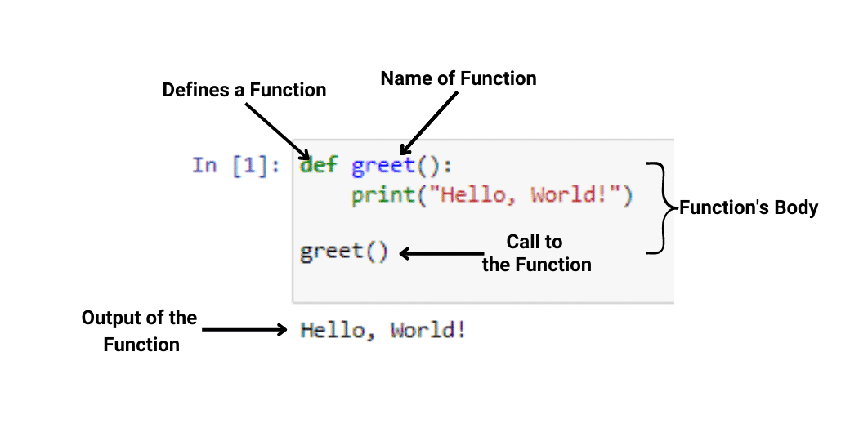

Slide 6
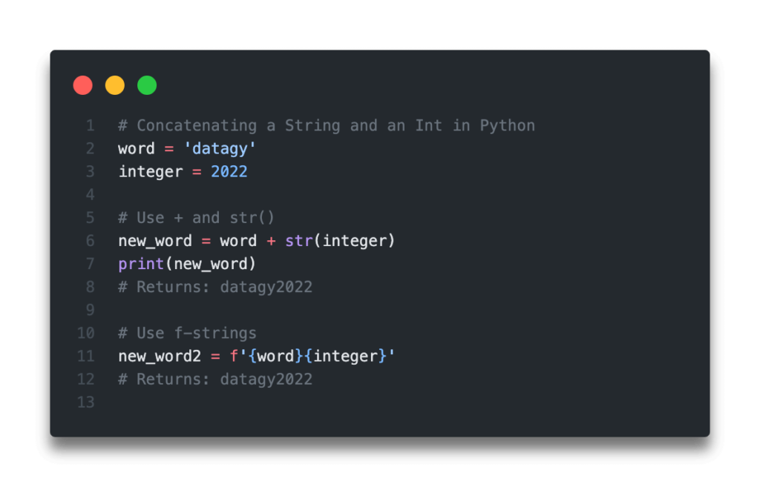
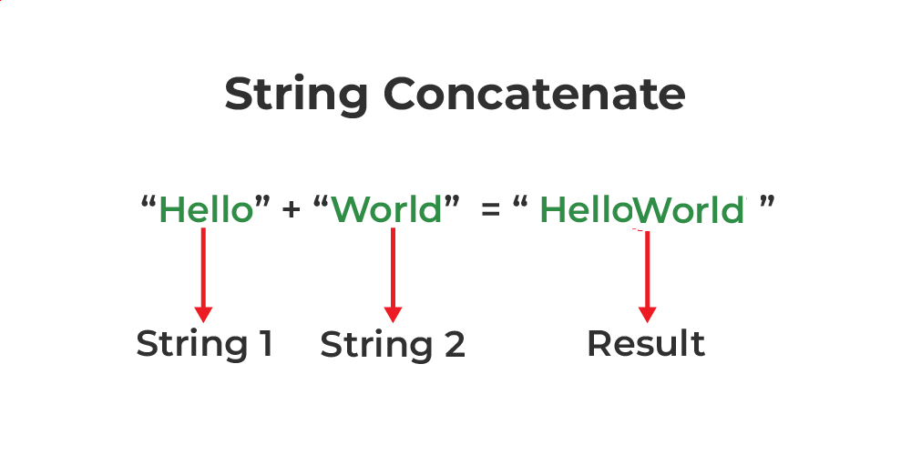
String Concatenation

